Slide 1
Processes in Linux
Network Operating Systems Security
Andrew.Beatty@ATU.ie

Slide 2
What is a Process?​
A running instance of a program​
Unique Process ID (PID)​
Uses CPU, memory and I/O​
Created and managed by kernel​
They can also have terminals associate with them,
Can have priorities

Slide 3
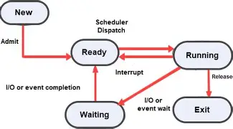
Proccess lifecycle

Slide 4
States
Letter | State | Description
R | Running | Process is currently running or ready to run on a CPU.
S | Sleeping | Interruptible sleep. Waiting for an event such as keyboard input, network traffic, or a timer. This is the most common state.
D | Uninterruptible Sleep | Usually waiting for disk or I/O operations. Signals generally cannot interrupt the process.
T | Stopped | Suspended by a job-control signal such as Ctrl+Z (SIGTSTP).
t | Traced/Stopped | Stopped by a debugger such as gdb.
Z | Zombie | Process has finished execution but its parent has not yet collected its exit status.
I | Idle Kernel Thread | An idle kernel thread waiting for work.
X | Dead | Dead process. Rarely, if ever, seen.
W | Paging | Historical state; not used on modern Linux kernels.

Slide 5
Forground and background
& at the end of a process runs in the background
Ctrl-z suspends a process
bg runs a job in the background
fg moves a job to the forground
kill sends a terminate sigmal to a process
Kill -9 terminates a process (forcefully)

Slide 6
Nice is used to set priorities
The lower the number the higher the priority
nice –n 10 sleep 300

Slide 7
There is a lab associated with this

